Slide 1
DDOS attacks Detection based on RDF-SVM
Batch-16
By
K.Yasaswi (Y16CS869)
K.Vamsi (Y16CS882)
N.Sai Phanindra (Y16CS905)
Guide: Sri.CH.Ratna Babu

Slide 2
ABSTRACT
Effective Detection of DDOS Attacks.
Detection based on feature selection.
Exploiting Random Forest for computing feature importance.
SVM used to rescreen the features.
Finally, an optimal feature subset is obtained, which will reach a higher detection rate and recall rate.

Slide 3
Proposed Algorithm RDF-SVM
Combination of RANDOM FOREST and SVM.
Random Forest:
- Large collection of decorrelated decision trees.
- Construct multiple decision trees randomly, and gains the final classification result by voting.
3. SVM:
- performs well in generalization and handling with imbalanced dataset.

Slide 4
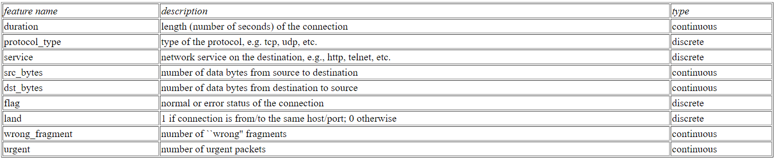
KDD99 DATASET

Slide 5
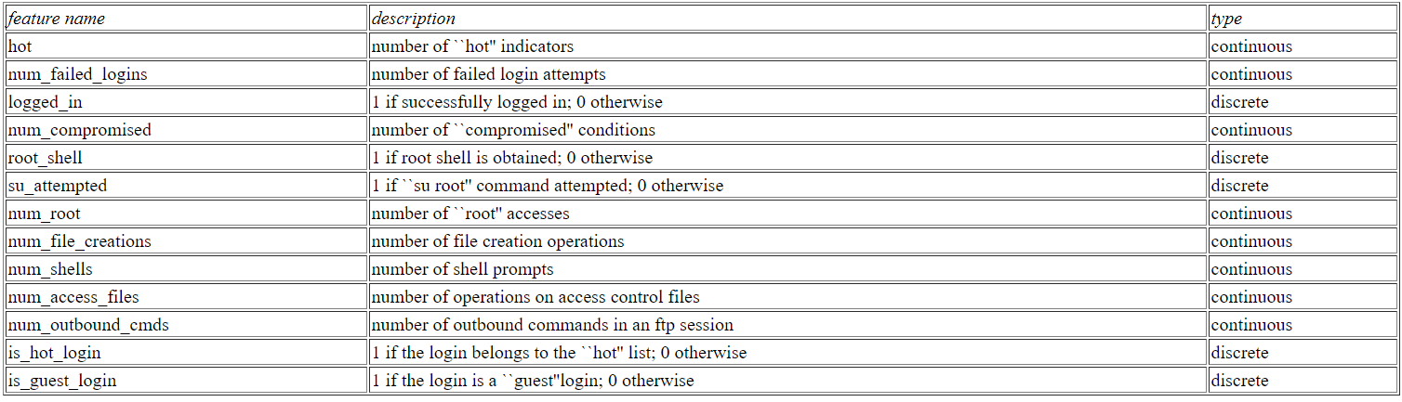
KDD99 DATASET

Slide 6
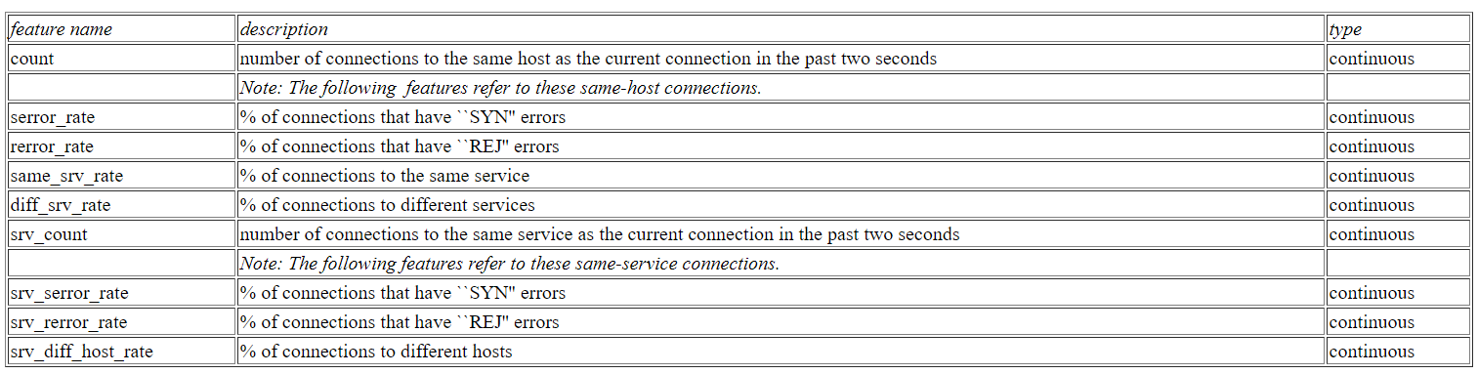
KDD99 DATASET

Slide 7
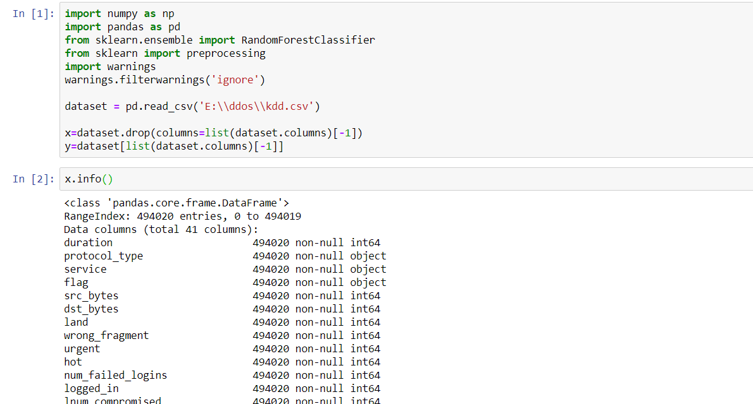
Implementation

Slide 8
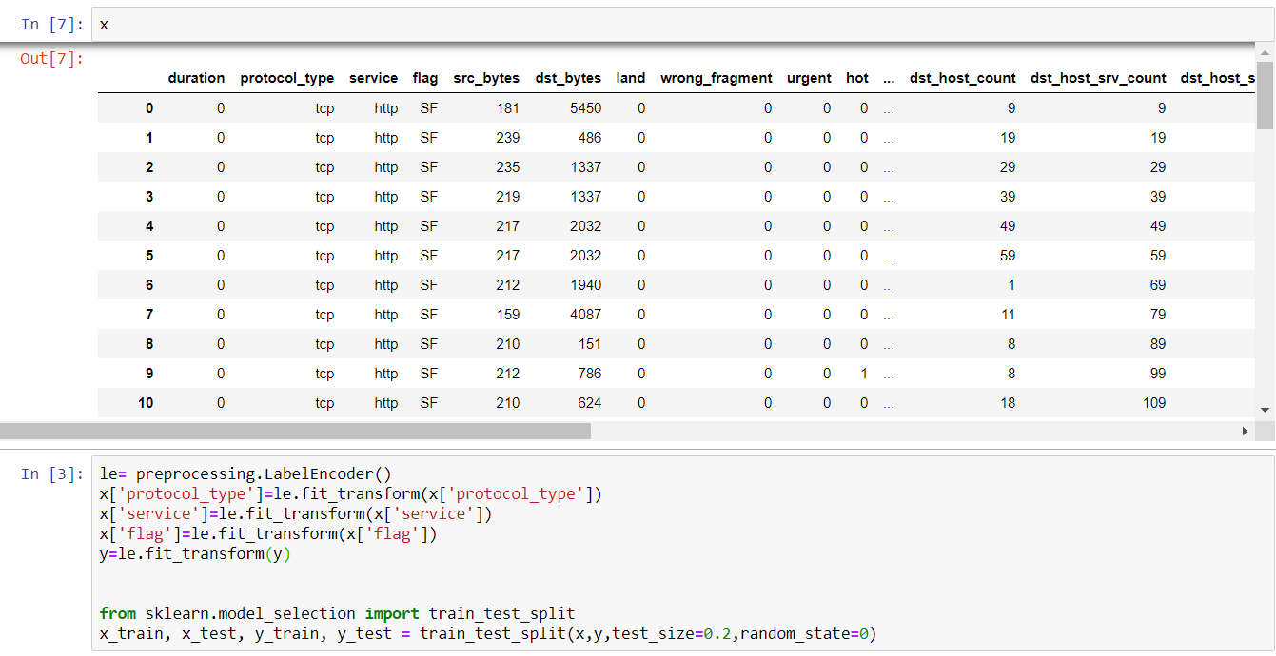
Contd..

Slide 9
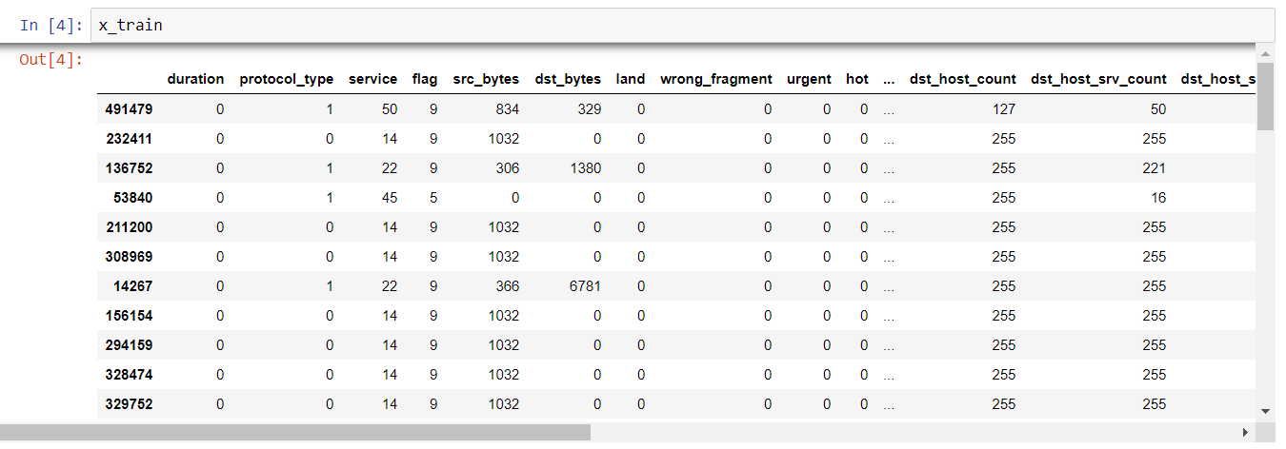
Contd..

Slide 10
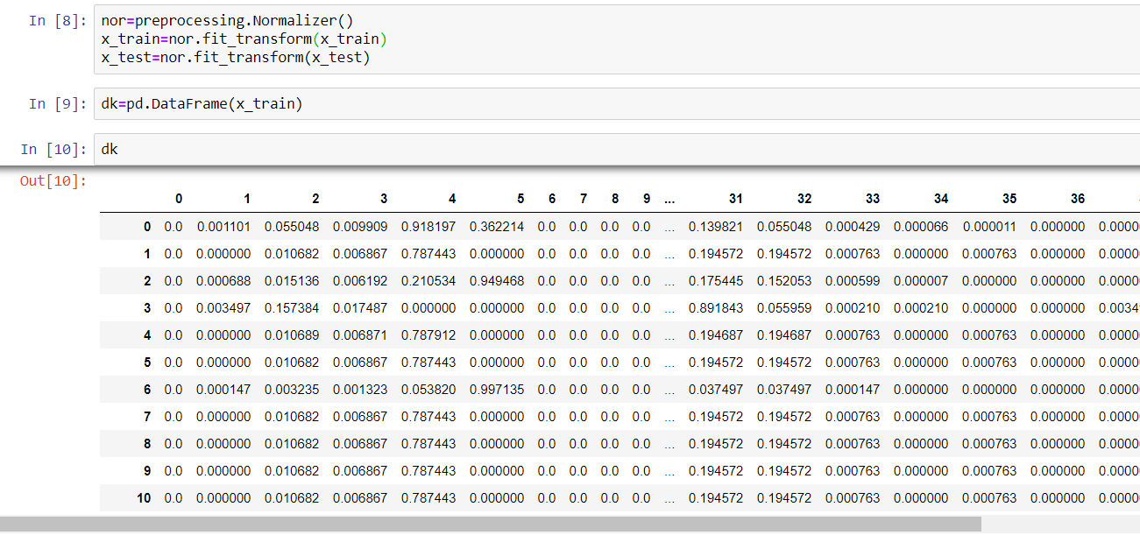
Contd..

Slide 11
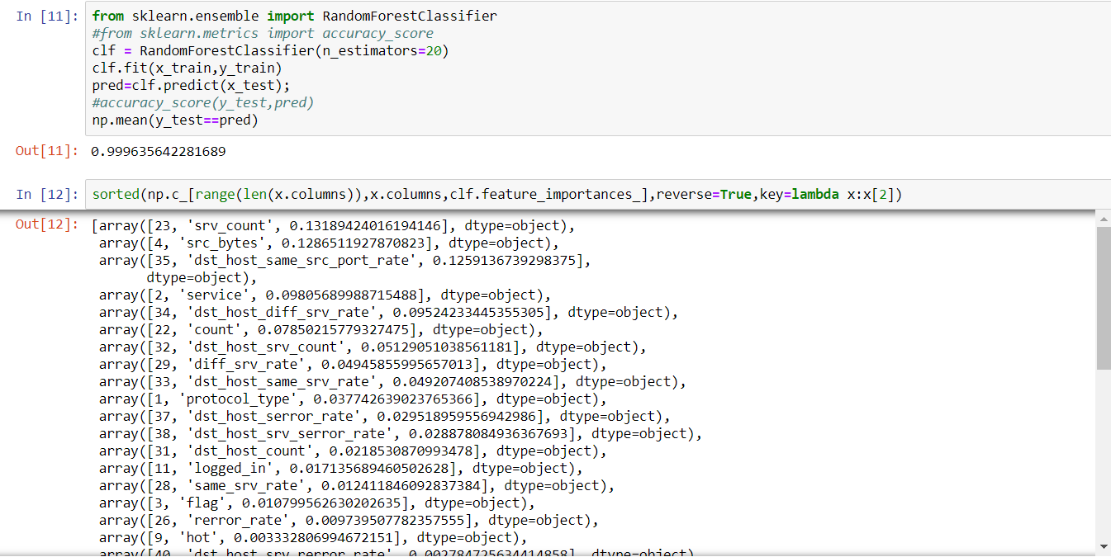
Contd..

Slide 12
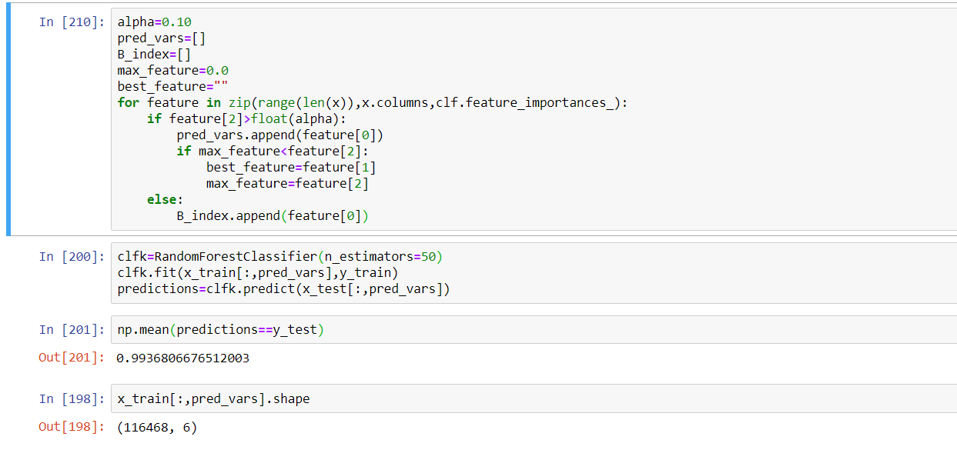
Contd..

Slide 13
Thank You

